Slide 1
CSE357:
COMBINATORIAL STUDIES

Slide 2
Unit I: Operating System Basics
Foundations of Operating Systems
Types of Operating Systems
Memory Management
Job Scheduling and Process Loading, Processor Scheduling Algorithms
Process Synchronization and Inter-process Communication
Resource Management
Disc structure and Scheduling, Protection mechanisms

Slide 3

Introduction to Operating System
The software that manages computer hardware and provides services for computer programs.

Slide 4
Types of Operating Systems:
Batch Operating System
Time-Sharing Operating System
Multiprogramming Operating System
Multitasking Operating System
Real-Time Operating System (RTOS)
Distributed Operating System
Network Operating System(NOS)
Embedded Operating System
Mobile Operating System
Single-User Operating System
Multi-User Operating System

Slide 5
Kernel
The core component of an operating system that provides essential services.
Types of Kernels:
Monolithic Kernel
Microkernel
Hybrid Kernel
Exokernel
Nanokernel
Real-Time Kernel
Hypervisor (Virtualization Kernel)
Hurd Microkernel
Windows NT Kernel
Linux Kernel

Slide 6
System Calls
System calls allow user-level processes or programs to request services or functionality from the operating system kernel.
Types of System Calls:
Process Control System Calls
File Management System Calls
Device Management System Calls
Information Maintenance System Calls
Communication System Calls
Memory Management System Calls
Network Communication System Calls

Slide 7
Process
A program in execution.
Types of Processes:
Foreground Process
Background Process
Parent Process:
Child Process
Daemon Process
Orphan Process
Zombie Process
Critical Process
Batch Process
User-Level Process
System-Level Process
Cooperative Process
Preemptive Process
Foreground Process

Slide 8
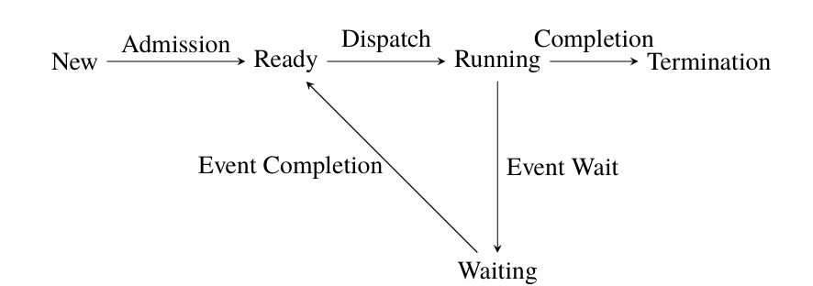
Process State Transition Diagram
New
Ready
Running
Waiting (Blocked)
Terminated

Slide 9
CPU Scheduling
CPU scheduling manages the execution of processes in a computer system with a single central processing unit (CPU)
Various CPU Scheduling Algorithms:
First-Come-First-Serve (FCFS)
Shortest Job Next (SJN) or Shortest Job First (SJF)
Priority Scheduling
Round Robin (RR)
Multilevel Queue Scheduling
Multilevel Feedback Queue Scheduling
Highest Response Ratio Next (HRRN)
Lottery Scheduling

Slide 10
Thread
A thread is the smallest unit of execution within a process.
Types of Threads:
User-Level Threads
Kernel-Level Threads
Thread Models:
Many-to-One Model
One-to-One Model
Many-to-Many Model
Hybrid Model

Slide 11
Synchronization
Process or thread synchronization is a mechanism employed in operating systems to control the access to shared resources by multiple processes or threads.

Slide 12
Process or Thread Synchronization
It is employed to control the access to shared resources by multiple processes or threads.
Some key concepts related to synchronization:
Critical Section
Mutual Exclusion
Semaphore
Mutex (Mutual Exclusion)
Condition Variable
Deadlock
Race Condition
Atomic Operations
Barrier
Read-Write Lock
Busy Waiting

Slide 13
Deadlock
A deadlock is asituation in computing where two or more processes are unable to proceed because each is waiting for the other to release a resource.
The occurrence of a deadlock requires the simultaneous satisfaction of four conditions:
Mutual Exclusion
Hold and Wait
No Preemption
Circular Wait

Slide 14
Types of Memory
Primary Memory (Main Memory)
RAM
ROM
Secondary Memory (Storage Devices)
Hard Disk Drives (HDD)
Solid State Drives (SSD)
Flash Drives (USB Drives)
Optical Drives (CDs, DVDs, Blu-rays)
Cache Memory L1, L2, and L3 Cache
Registers
Virtual Memory
Graphics Memory (GPU Memory)
Memory Cards

Slide 15
Memory Management Schemes
Fixed Partitioning
Variable Partitioning
Memory Allocation Algorithms:
Paging
Demand Paging
Segmentation

Slide 16
RAID (Redundant Array of Independent Disks)
RAID is a technology used to improve the performance and reliability of computer storage.
RAID Levels:
RAID 0 (Striping)
RAID1(Mirroring)
RAID5(Striping with Distributed Parity)
RAID6(Striping with Dual Parity)
RAID10(Striping and Mirroring)

Slide 17
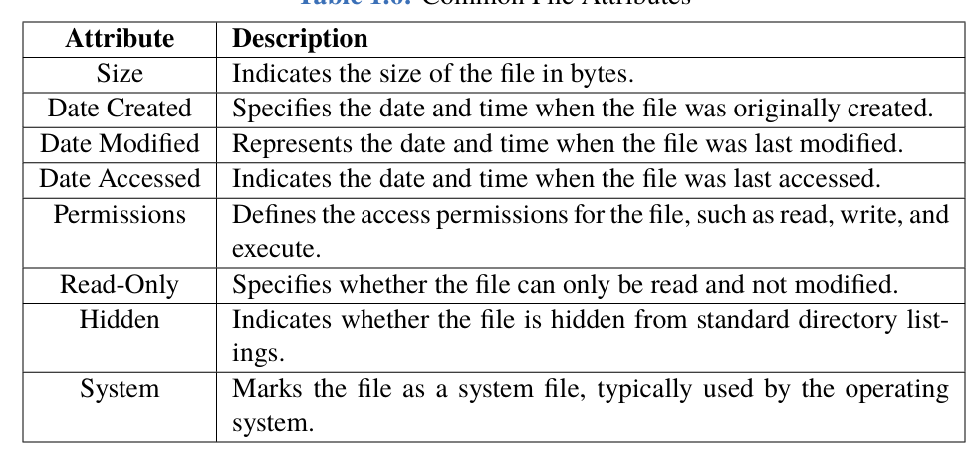
File System
Common File Attributes

Slide 18
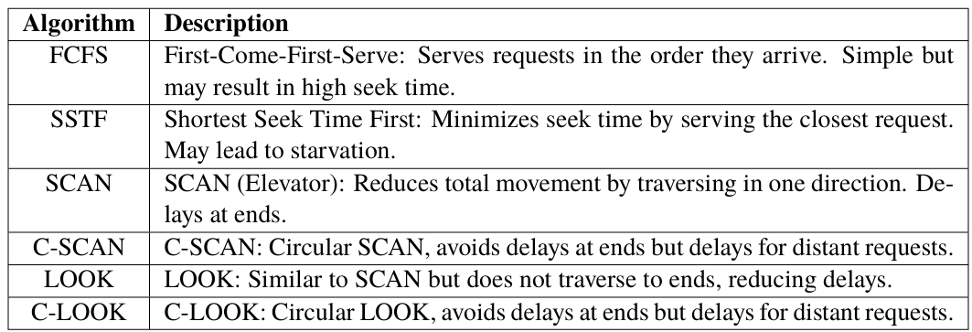
Disc Scheduling

Slide 19
Web Links For Reference (Complete Video Course)
https://youtube.com/playlist?list=PLsylUObW5M3CAGT6OdubyH6FztKfJCcFB&si=v1v4jchTBSJYXOwq
https://youtube.com/playlist?list=PLyqSpQzTE6M9SYI5RqwFYtFYab94gJpWk&si=ilqHadOgkv5osVpj
https://youtube.com/playlist?list=PLBlnK6fEyqRiVhbXDGLXDk_OQAeuVcp2O&si=7ELRRSTFhYXv5-xg

Slide 20
Web Links For Reference (Study Material)
https://www.geeksforgeeks.org/operating-systems/
https://www.javatpoint.com/operating-system
https://www.tutorialspoint.com/operating_system/os_overview.htm

Slide 21
NEXT----> Database Management Systems
Introduction to Databases and RDBMS
Basics of Databases and RDBMS
Data Definitions: Tables, Fields, Records, SQL and Data Manipulation, Database Keys and Data Integrity
Database Normalization and Transactions
Fundamentals of Normalization
Transaction Management in DBMS

